Slide 1

MATH 285 Week 10
DI 2

Slide 2
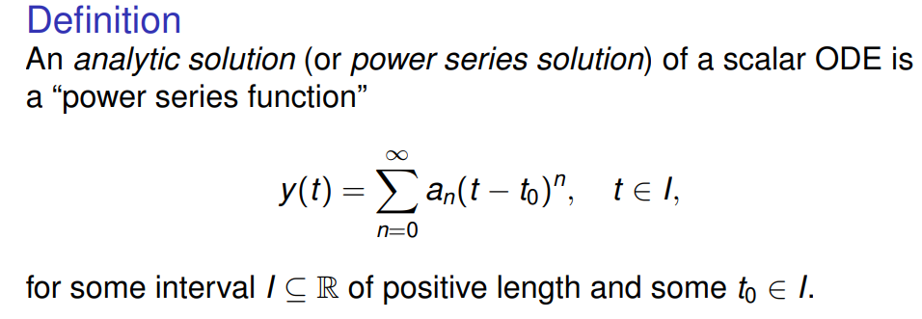
Analytic solution for ODEs
Expand the solution at t = t0

Slide 3
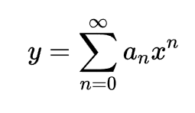




Some remarkable equations

Slide 4


When can we expand? -- Regular and Singular Points Definition

Slide 5
